Slide 1

WIPRO NGA Program – Connectivity NMS Java Developer Batch
Capstone Project Presentation – 13th Aug 2024
Project Title – Configuration Management Microservice
Presented By – Team B
www.rpsconsulting.in

Slide 2

Presented By: Team B/2 01 Sharmila Maity 05 Shraddha Vijay Sonkusale 09 Shriram Chandrashekhar Patil 16 Siddala Madhu 19 Sri Harsha R (Team Lead) 20 Sri Maha Lakshmi Bheemireddy 34 Yuva Ramya

Slide 3
Agenda
Configuration Management Microservice:
GNS3 network setup
Configuration Push
Configuration Backup
Configuration Logs
User interface for configuration management.
Testing and Documentation

Slide 4
Project Overview
Introduction: This project is focused on developing a network management system that provides configuration management capabilities for network devices. It aims to streamline the process of managing device configurations in a secure and efficient manner.
Purpose: The main goal is to create a microservice-based solution that allows network administrators to backup, restore, and push configurations to network devices, ensuring consistency and reducing manual effort.
Scope: The project includes the development of microservices for configuration backup, logs, and push operations. It also involves creating a user interface for easy management and interaction with network devices.
Technologies Used: The project utilizes Java Spring Boot for the backend, JSch for SSH connections, and JUnit for testing.

Slide 5
Development Environment Tools
IDEs (Integrated Development Environments):
Spring Tool Suit: Another robust IDE for Java development, known for its extensibility and comprehensive tooling support.
JDK 21: Java Development Kit, providing essential libraries, tools, and runtime components required for developing
Build Tools:
Maven: A build automation tool used for managing project dependencies, builds, and documentation
GNS3: GNS3 is a network simulation tool that allows users to design, configure, and test complex network topologies virtually
Version Control:
Git: A distributed version control system for tracking changes in source code, enabling collaboration and version management.

Slide 6

Network Management System (NMS)

Slide 7
What is NMS?
A Network Management System (NMS) is a set of tools and software used to monitor, manage, and maintain network infrastructure and services. Its primary functions include:
Monitoring: Tracking the performance and health of network devices (like routers, switches, and servers) and services. This include uptime, traffic patterns, and error rates.
Configuration Management: Managing the configuration of network devices and services. This includes applying configuration changes, backups, and updates.
Fault Management: Detecting, diagnosing, and resolving network issues. This includes alerting administrators to problems and providing tools for troubleshooting.
Performance Management: Analyzing network performance metrics to ensure efficient operation and to identify areas for improvement.
Security Management: Monitoring for and responding to security threats and vulnerabilities.

Slide 8
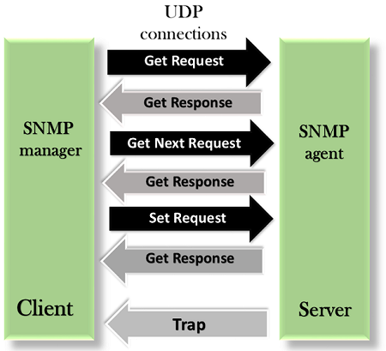
SNMP, NETCONF & RESTCONF:
SNMP:
Simple Network Management Protocol , or SNMP, is a widely adopted protocol for managing and monitoring network devices like routers, switches, servers, printers, and more.
SNMP has two components Manager and Agent.

Slide 9
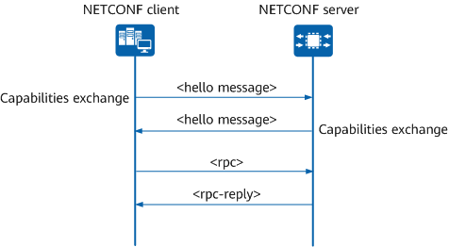
NETCONF:
It was developed to provide a standardized interface to Network Devices to retrieve and manipulate configuration data. It uses RPC’s which contain well-defined XML messages that are very easy to handle inside software application.

Slide 10
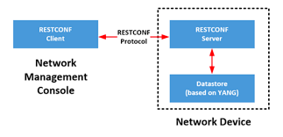
3. RESTCONF:
RESTCONF is an HTTP-based protocol that provides a programmatic interface for accessing data defined in YANG.

Slide 11
SNMP, NETCONF, RESTCONF:
 | SNMP | NETCONF | RESTCONF
Standard | IETF | IETF | IETF
Resources | OIDs | Paths | URLs
Data Models | Defined in MIBs | YANG Core Models | -
Management Operations | SNMP | NETCONF | HTTP operations
Transport Stack | UDP | SSH TCP | SSL HTTP TCP

Slide 12
Graphical Network Simulator-3 (GNS3)

Slide 13
What is GNS-3?
A powerful network simulation and emulation tool.
Purpose: Design, configure, and test network topologies in a virtual environment.
Key Features:
Device Emulation: Emulates real network devices (routers, switches, firewalls) using software images.
Simulation: Supports the simulation of network configurations and scenarios.
Graphical Interface: Intuitive drag-and-drop interface for designing network topologies.
Cross-Platform Support: Available for Windows, macOS, and Linux.

Slide 14
Router Commands:
enable: Enters privileged exec mode.
Configure terminal: Enter global configuration mode
Hostname: Sets the name of the router
Ip domain-name: Sets the domain name of the router
Crypto key generate rsa: Generates RSA keys for SSH access
Username: Creates a new user account with specified privileges
Ip ssh version 2: Configures the router to use SSH version 2

Slide 15
Router Commands:
8. Interface: Configures a specific interface on the router
9. ip address: Assigns an IP address and subnet mask to the interface
10. Ip nat inside/outside: Designates the interface as inside or outside for NAT
11. Ip nat inside source list: Configures NAT overload based on an access list
12. Access-list: Creates an access list to permit or deny traffic
13. Write memory: Saves the current configuration to NVRAM

Slide 16
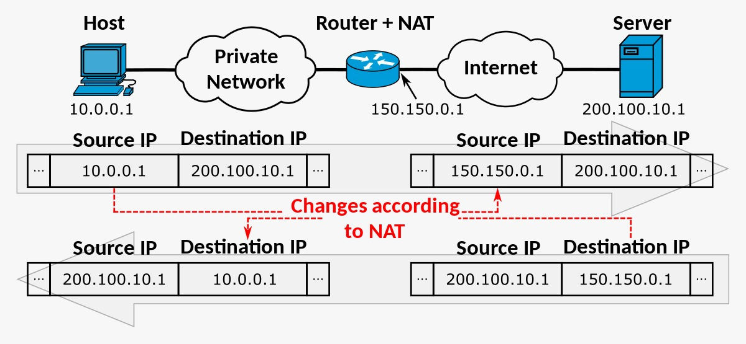

Slide 17
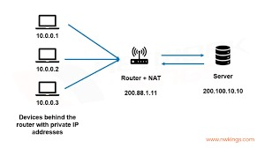
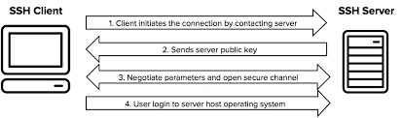

Slide 18
Configuration Protocols
1. SCP (Secure Copy Protocol):
Purpose: Provides secure file transfers over SSH, offering encryption and security.
Usage: Preferred for transferring sensitive configuration files to ensure confidentiality and integrity.
2.HTTP (Hypertext Transfer Protocol):
Purpose: Used for web-based interfaces and configuration management tools.
Usage: Allows for the management and retrieval of configuration files through web-based systems, often over HTTPS for added security.

Slide 19
HTTP Methods:
GET: Requests data from a specified resource. It is the most common method used to retrieve web pages.
POST: Submits data to be processed to a specified resource, typically used for form submissions.
PUT: Updates or replaces a resource on the server.
DELETE: Removes a specified resource from the server.
HEAD: Similar to GET but only retrieves the headers, not the body, of a resource.
OPTIONS: Describes the communication options for the target resource.
PATCH: Applies partial modification to a resource.

Slide 20
Modules Used In Project 1.Push Configuration Module
Purpose: Pushing configuration changes involves sending commands to network devices, such as routers, to update their settings. This ensures that the devices operate according to the latest configurations.
User Interface: Start the process by clicking the “Push configuration” button.
Technologies Used: We have utilized JSch for SSH connections, Spring Data JPA for database operations, and REST APIs for seamless communication between the services.
Command Execution: Commands are executed on the network device to implement the necessary configuration changes.

Slide 21
2.Backup Configuration Module
Purpose: Ensure that the current configurations of network devices, like routers, are safely backed up.
User Interface: Provide an option in the UI to start the backup process (e.g., "Backup Configuration" button).
Capture Configuration: Capture and store the current configuration of network devices to safeguard against data loss and enable recovery. Save the captured configuration to a secure storage location. Use a standardized format (e.g., text file) for easy retrieval and restoration.
Command Used: Use the command “show running-config” to capture the current configuration.

Slide 22
3. Change Tracking and Logging
Purpose: Ensure that logs from GNS3 are accurately retrieved and saved into a local file.
User Interface: Provide an option in the UI to start the log process (e.g., “Log Configuration" button).
Operation Logging: Log each operation, noting any issues or changes made for audit and troubleshooting purposes.
File Operation: Create a file to save the log by providing the appropriate commands.
Command: Use the command show logging to display the current logging information and verify that logs are being collected correctly.

Slide 23
User Interface for Configuration Management
Developed a user-friendly interface for managing device configurations.
The user interface (UI) for configuration management includes the following components:
The Device Page serves to list and view device details, presented in a table format with columns for Device, Device Name, and Device IP.
The Dashboard Page provides action options through buttons labeled “Push”, “Backup”, and “Log File”, each redirecting users to the corresponding form pages.
The Form Pages are designed to collect action-specific data, featuring distinct forms for “Push”, “Backup”, and “Log File” with submission functionality.

Slide 24
In terms of CSS & Styling, the Device Page ensures a clear table design, the Dashboard Page focuses on making buttons visible, and the Form Pages maintain consistent input field styling for user-friendliness.
HTML (HyperText Markup Language) is the standard language for creating web pages. It structures and formats content on the web using elements and tags. HTML organizes text, images, links, and multimedia into a readable format for browsers. It forms the backbone of most web content, providing a framework for design and interactivity.

Slide 25
Thymeleaf:
Thymeleaf is a Java library, and template engine used to parse and render the data produced by the application to template files.
It allows caching of the parsed data/file to increase efficiency while in production
How Thymeleaf work with Spring-Boot?
Thymeleaf follows a De-Coupled Architecture. It is unaware of any web framework.
In the same way, it is unaware of Spring’s abstraction of the model and thus cannot handle the data that the controller places in the Model.
When Spring Boot’s autoconfiguration detects Thymeleaf in the classpath, it creates beans supporting Thymeleaf view for Spring MVC.
It can work with request attributes of Servlet.
Therefore, Spring copies the model data into request attributes that the Thymeleaf template can work with.

Slide 26
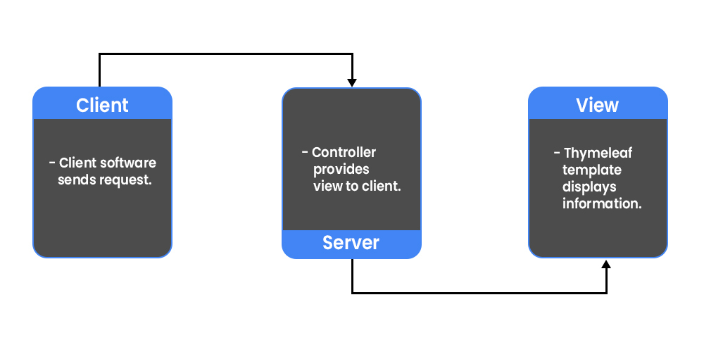
Simple Life-Cycle of Thymeleaf Template:

Slide 27
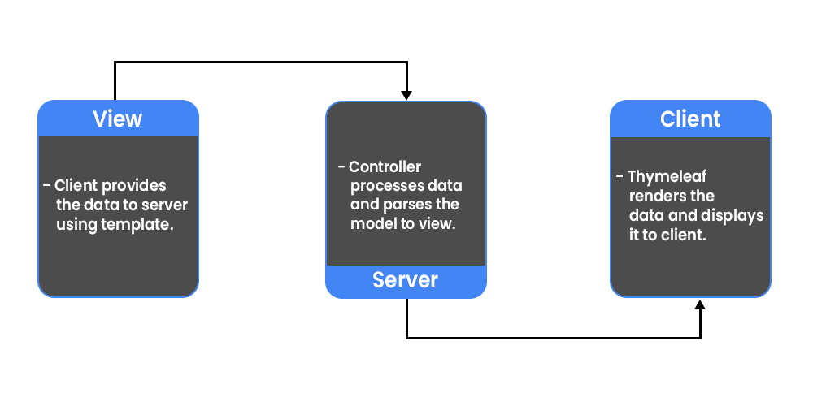

Slide 28
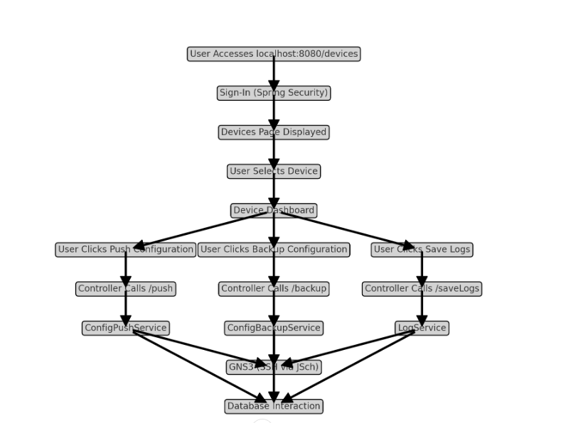
Project Flow Chart:

Slide 29
System Architecture Overview:
1. Client/UI Layer
Browser Interface: Users interact with the system through a web browser.
UI Components:
Sign-In Page: Handled by Spring Security, displayed when users access localhost:8080/devices.
Devices Page: Lists all network devices (routers, switches, etc.) fetched from the database. Clicking on a device name redirects to a device-specific dashboard.
Device Dashboard: Displays three buttons:
Push Configuration: Redirects to a form where users submit configuration commands.
Backup Configuration: Redirects to a form where users submit a filename for the backup.
Save Logs: Saves the logs and redirects to a confirmation page.

Slide 30
2. Controller Layer (Spring MVC)
DevicesController:
/devices: Handles requests to display the list of devices. Interacts with the service layer to fetch device data from the database.
/push: Handles push configuration requests. Calls the ConfigPushService to execute commands via SSH.
/backup: Handles backup configuration requests. Calls the ConfigBackupService to create and save the backup file.
/saveLogs: Handles log saving requests. Calls the LogService to save logs to a file.

Slide 31
3. Service Layer
DeviceService: Interacts with the repository layer to fetch the list of devices from the database.
ConfigPushService: Implements the logic for pushing configurations to devices. Establishes an SSH connection to the device using JSch, then executes the provided commands.
ConfigBackupService: Implements the logic for backing up device configurations. Executes show running-config over SSH and saves the output to a file.
LogService: Implements the logic for saving logs from devices to a local file.

Slide 32
4. Repository Layer (Spring Data JPA)
DeviceRepository: Provides CRUD operations for the Device entity, which maps to the devices table in the database.
5. Model/Entity Layer
Device: A POJO representing the device entity. Maps to the devices table in the database, containing fields like id, device, and deviceName.
6. External Systems
GNS3: The virtual network environment where devices like routers and switches are configured.
SSH Communication: JSch is used to establish SSH sessions with devices in GNS3 to execute configuration commands, backup configurations, and save logs.
7. Security Layer
Spring Security: Manages authentication and authorization. Users must log in to access the /devices URL and other functionalities.

Slide 33
8. Database Layer
Database: Contains the devices table, storing information about network devices.
Spring Data JPA: Manages interaction with the database, automatically generating queries based on the repository interfaces.
Flow Diagram (Summary)
User requests /devices → Controller fetches and displays device list from the database.
User clicks a device → Redirect to dashboard.
User clicks "Push Configuration" → Controller calls ConfigPushService to execute commands via SSH.
User clicks "Backup Configuration" → Controller calls ConfigBackupService to save configuration.
User clicks "Save Logs" → Controller calls LogService to save logs to a file.

Slide 34

Testing and Documentation

Slide 35
Why Testing is Crucial:
Reliability: Ensures that the microservice functions correctly under various conditions, minimizing the risk of errors during configuration management.
Security: Helps identify potential vulnerabilities in the code, particularly in areas handling network connections and data transfers.
Maintainability: Provides a safety net that allows developers to make changes to the code with confidence, knowing that tests will catch regressions.
Quality Assurance: Verifies that the implemented features meet the specified requirements and perform as expected.

Slide 36
JUnit Overview:
JUnit is a popular open-source framework for writing and running unit tests in Java. It plays a crucial role in the development process by helping developers ensure that their code behaves as expected.
JUnit facilitates the creation and execution of repeatable tests, which helps maintain code quality and reliability. It supports automated testing, making it easier to run tests frequently and consistently.
Why Use JUnit?
Ease of Use: Simple syntax and annotations (e.g., ‘@Test’, ‘@Before’, ‘@After’).
Integration: Works with Maven, Gradle, etc.
Automation: Supports automated, repeatable tests and test suites.

Slide 37
Push Configuration Test:
Objective: Ensure that the pushConfig method successfully pushes configuration commands to a network device, handling file operations, and SSH communication correctly.
Testing Approach:
Unit Testing with JUnit:
File Operations: Verify that commands are correctly written to a file. Test that the file is created if it doesn't exist.
SSH Communication: Mock SSH connection to ensure the method sends commands accurately to the router.
Error Handling: Simulate file I/O and SSH connection errors to test exception handling.
Test Cases:
Valid Commands
Empty Commands
File Creation Failure
SSH Connection Failure

Slide 38
Push Configuration Test:
Results:
Successful Execution:
Commands were correctly written to the file and sent to the router.
Proper exception handling for file and SSH-related errors.

Slide 39
Backup Configuration Test:
Objective : Ensure that the backupConfig method correctly backs up the running configuration of a network device to a specified file, handling file operations, and SSH communication accurately.
Testing Approach:
3. Unit Testing with JUnit:
File Operations: Validate that the backup file is created in the specified directory. Test that the contents of the file match the output of the show running-config command from the router.
SSH Communication: Mock the SSH session to ensure the method correctly sends commands and reads responses from the router.
Error Handling: Simulate scenarios where file creation or SSH connection fails, testing the method's ability to handle these exceptions.

Slide 40
Backup Configuration Test:
4. Test Cases:
Successful Backup:
Invalid Directory:
SSH Connection Failure:
File Write Failure:
Results:
Successful Execution:
The method correctly backs up the running configuration and handles all possible exceptions.

Slide 41
Logs Test:
Objective: Ensure that logs from GNS3 are accurately retrieved and saved into a local file, handling file operations and communication with the GNS3 API correctly.
Testing Approach:
5. Unit Testing with JUnit:
Log Retrieval:
Mock the connection to the GNS3 API to ensure logs are correctly fetched from the specified GNS3 instances or devices.
File Operations:
Validate that the log file is created in the specified directory. Test that the logs are correctly written to the file.
Error Handling:
Simulate scenarios where file creation or GNS3 API communication fails, ensuring the method handles these exceptions properly.

Slide 42
Logs Test:
6. Test Cases:
Successful Log Saving:
Invalid Directory Path:
GNS3 Connection Failure:
File Write Failure:
Results:
Successful Execution:
Logs are accurately retrieved from GNS3 and saved into a local file. Proper exception handling ensures robustness against potential failures.

Slide 43
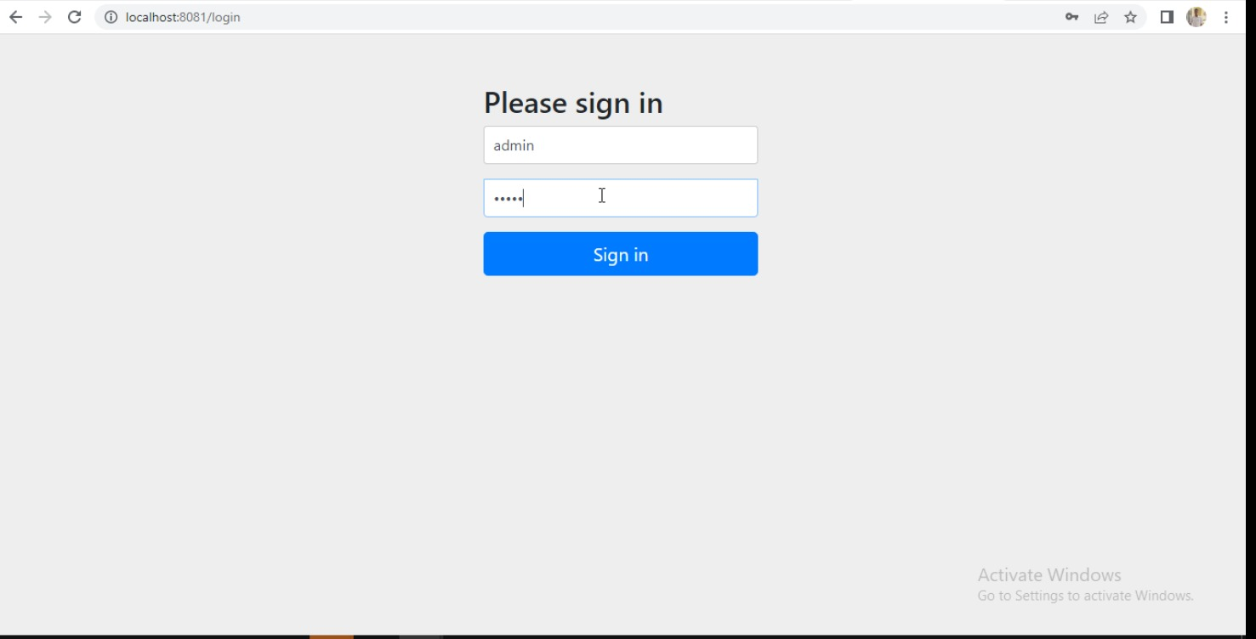
Outcomes and Results:

Slide 44
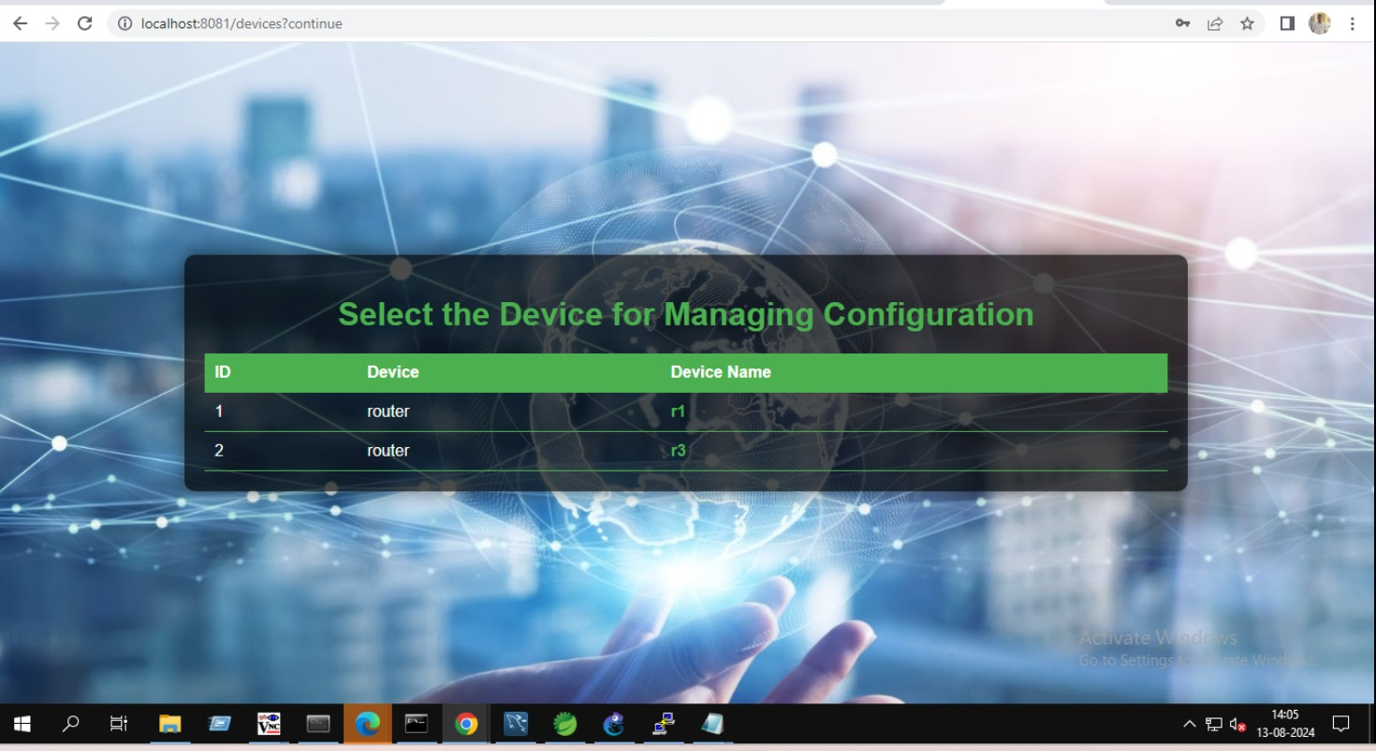
Outcomes and Results:

Slide 45
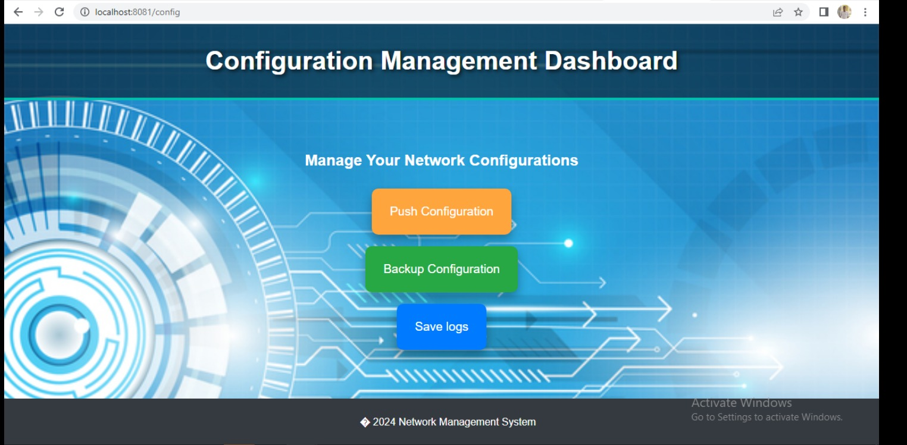
Outcomes and Results:

Slide 46
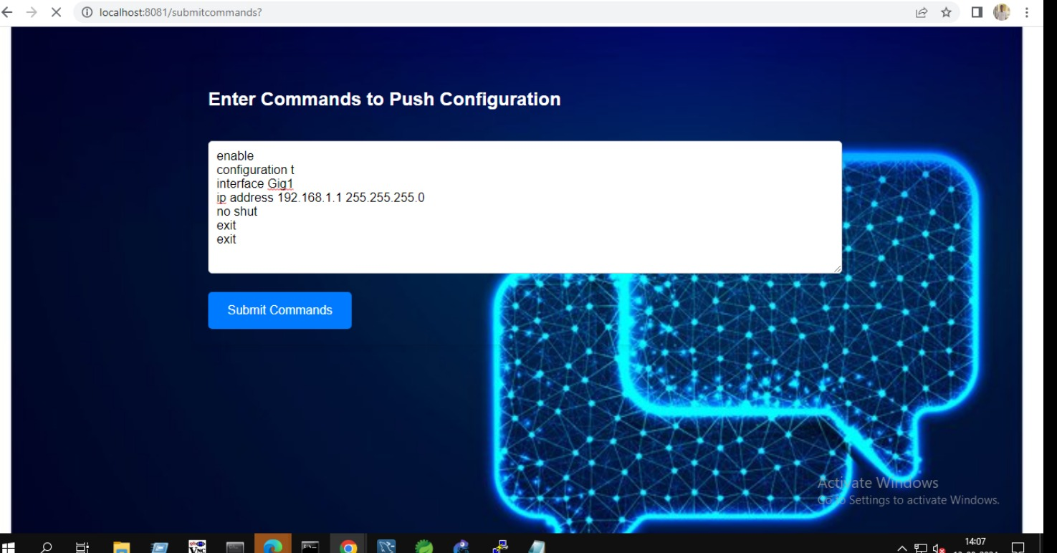
Outcomes and Results:

Slide 47
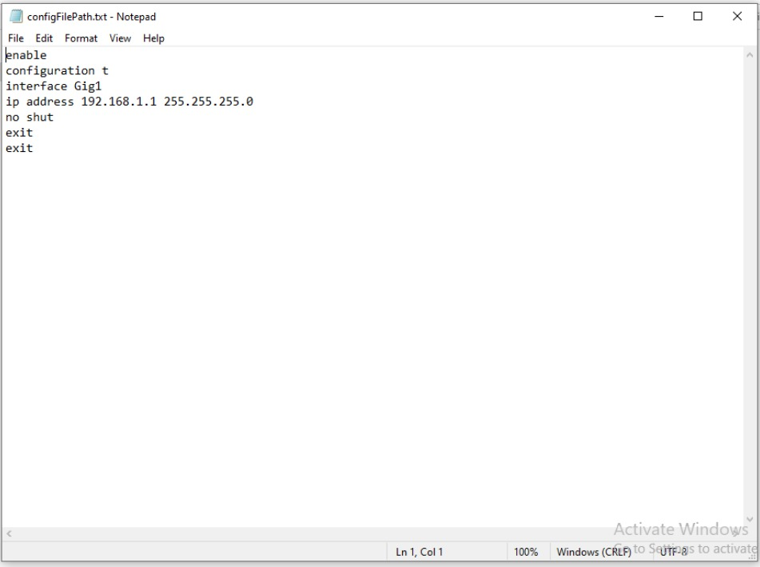
Outcomes and Results:

Slide 48
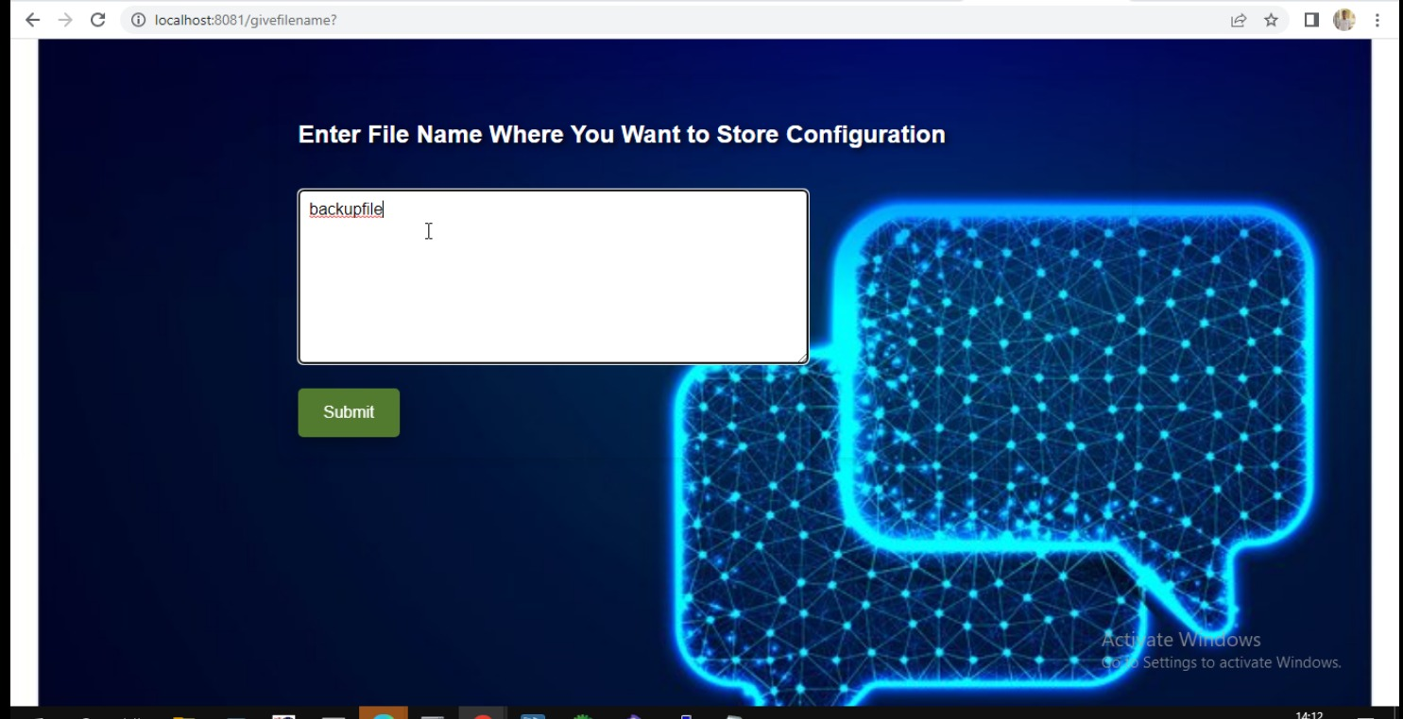
Outcomes and Results:

Slide 49
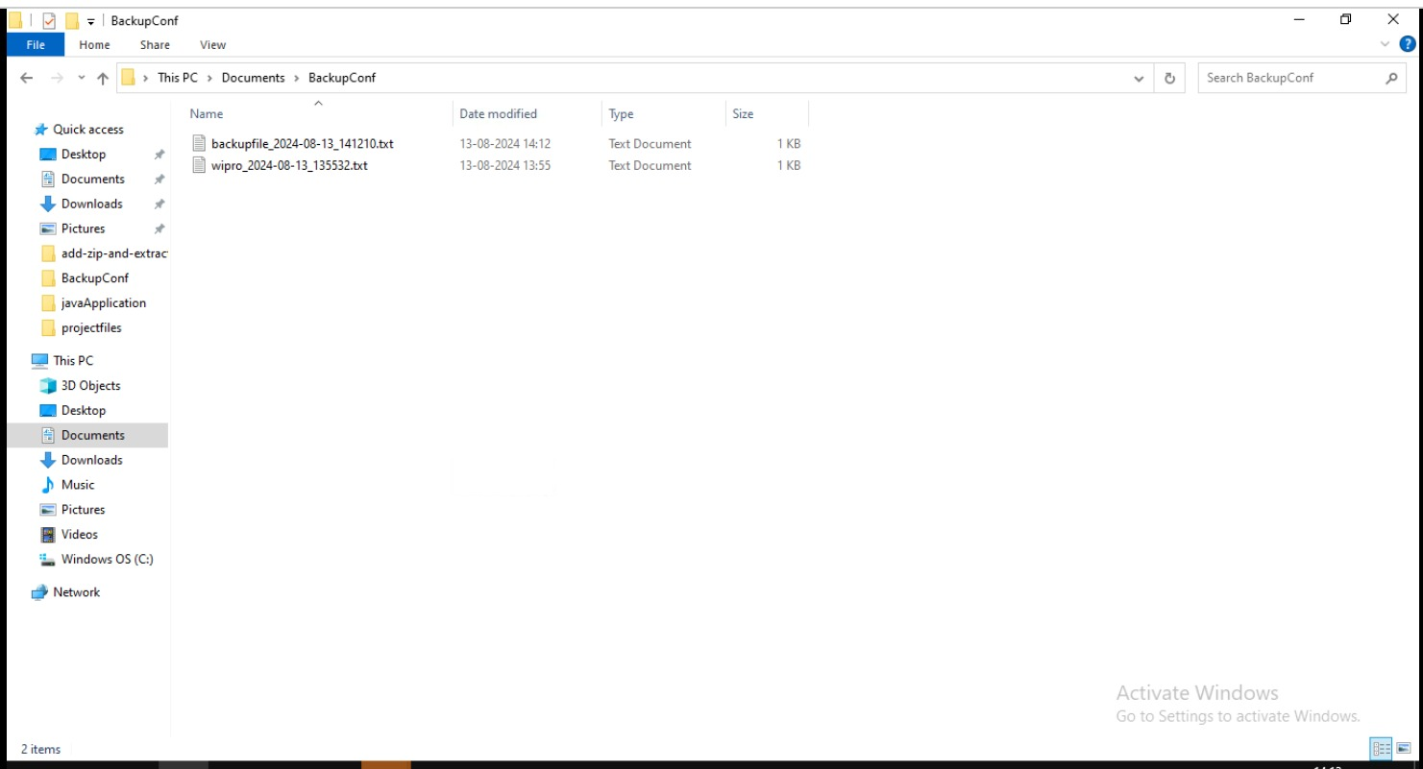
Outcomes and Results:

Slide 50
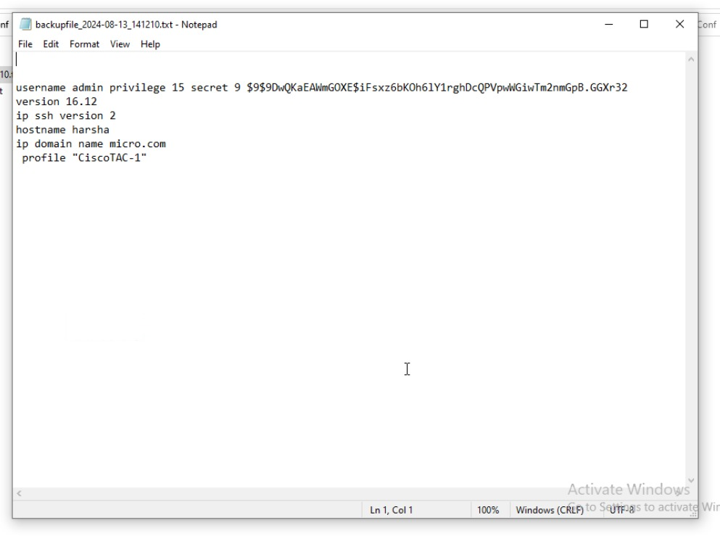
Outcomes and Results:

Slide 51
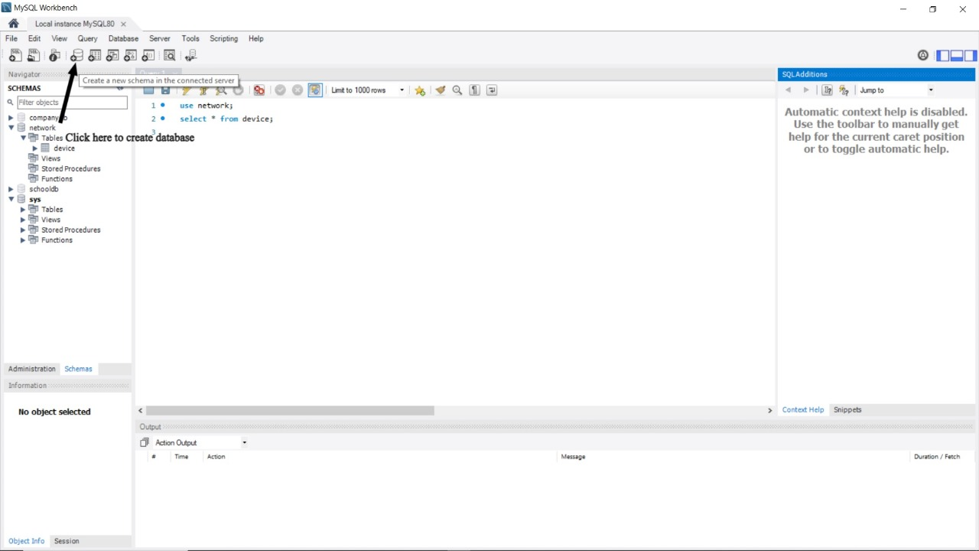
Outcomes and Results:

Slide 52
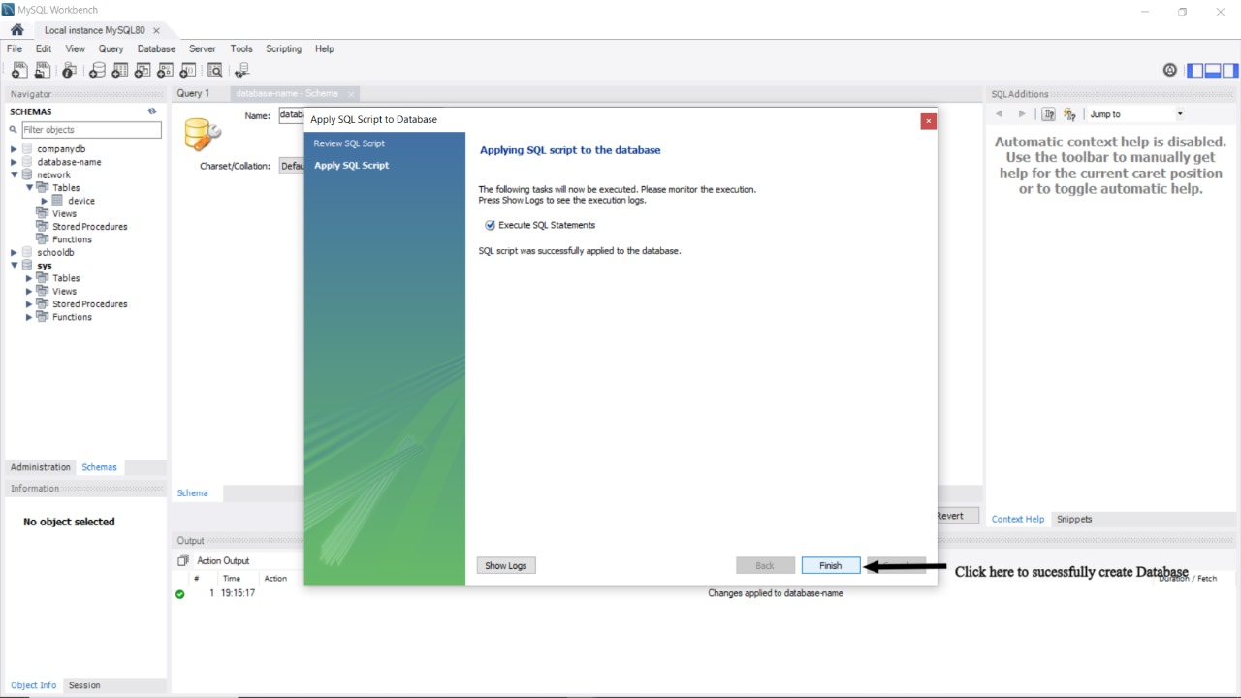
Outcomes and Results:

Slide 53
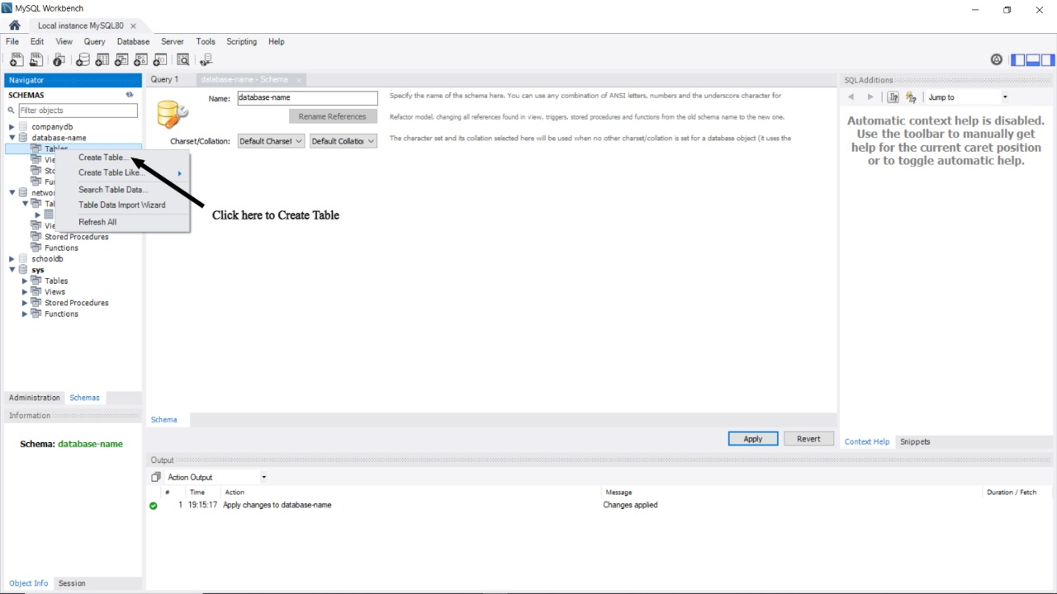
Outcomes and Results:

Slide 54
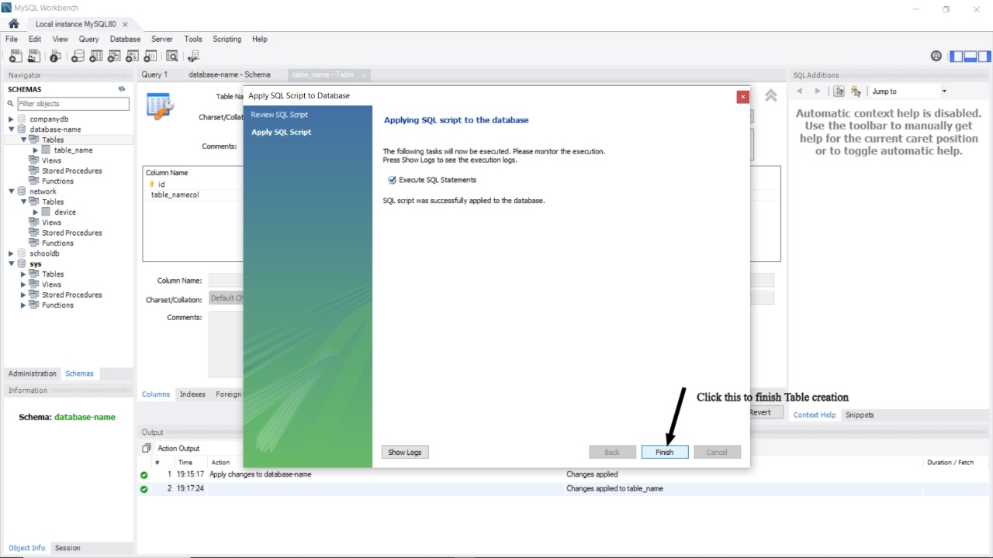
Outcomes and Results:

Slide 55
Conclusion:
In this project, we have successfully developed and implemented a robust configuration management microservice for Network Management Systems (NMS). This microservice effectively addresses three core functionalities: Push Configuration, Backup Configuration, and Log Configuration.
Push Configuration: Our microservice ensures seamless deployment of configuration updates across the network, enhancing consistency and reducing manual intervention. This functionality improves operational efficiency and supports rapid adaptation to changing network requirements.
Backup Configuration: By providing reliable and automated backup solutions, we ensure that critical configurations are preserved and can be restored promptly in the event of failures or accidental changes. This capability fortifies the resilience of network operations and safeguards against data loss.
Log Configuration: Comprehensive logging mechanisms enable detailed tracking and auditing of configuration changes. This functionality enhances transparency, facilitates troubleshooting, and supports compliance with regulatory standards.

Slide 56

Thank you
Team B/2
01 Sharmila Maity
05 Shraddha Vijay Sonkusale
09 Shriram Chandrashekhar Patil
16 Siddala Madhu
19 Sri Harsha R
20 Sri Maha Lakshmi Bheemireddy
34 Yuva Ramya

